Slide 1
What’s Next ?
4.4 Final Session

Slide 2

What’s next in coding journey?
Now that we’ve learned the basic concepts of how to create a website what should I do to continue with my coding journey?

Slide 3

FreeCodeCamp
FreeCodeCamp is one of the best resources paid or otherwise for learning and improving on your development skills. There is a wide range of qualifications that cover various aspects of coding extensively.
https://www.freecodecamp.org/

Slide 4
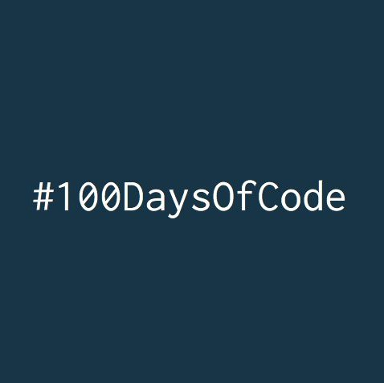
#100daysofcode
https://www.100daysofcode.com/
Code for minimum an hour a day
Tweet your progress daily with the hashtag: #100DaysOfCode
Each day, reach out to at least two people on Twitter who are also doing the challenge

Slide 5

Meetups
In pre-COVID times there was regular meetups that were ran in the Leeds area. There are meetups for lots of areas of coding/ development.
(There’s normally free beer and pizza)
https://www.meetup.com/

Slide 6

Side projects
Using your coding skills to create a vision you’ve had for an online business. Lot’s of the overheads around running a business can be ignored if you’re the developer. Even if your idea seems really big you can always be working towards an end goal.

Slide 7

Finding work
If you’re interested in finding work in the development industry an apprenticeship is a great place to start. You can try your luck at finding work as a junior in an office, however apprenticeships are a great way to get your foot in the door!

Slide 8
Questions?

